Slide 1
IOT Final Project “Follow Upets”
Presented by: Or Peretz – 313545683 Shahar Tal – 313357402
Git repository - https://github.com/chapost1/IOT_SMART_HOME
Video link – https://youtube.com/?watch=placeholder

Slide 2
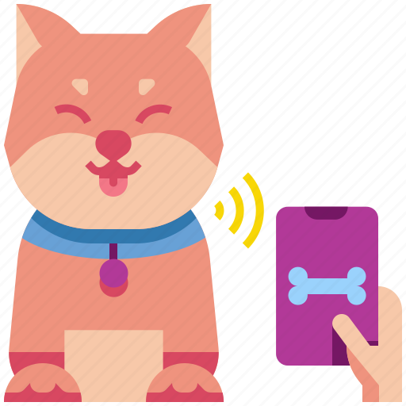
TABLE OF CONTENTS
01
Introduction
02
The solution – Our Product
03
Stakeholders
04
System requirements
05
Development plan
06
Architecture
07
POC Demo
08
Summary & Bibliography

Slide 3
Introduction

Slide 4
In today's fast-paced world, pets have become more than just animals! They are cherished members of our families, bringing joy and unconditional love into our lives. As devoted pet owners, we revel in the moments of playfulness, companionship, and the special bond we share with our furry friends.
However, there's one aspect of pet ownership that causes immense distress and fear for many: the heart-wrenching experience of losing a pet. Imagine the heartache of coming home to an empty house, searching frantically through the neighborhood, or plastering "Lost Pet" posters on every street corner. Unfortunately, this scenario is all too familiar for millions of pet owners worldwide. But what if there was a solution that could alleviate this anguish and provide a ray of hope in times of crisis? A solution that leverages the power of tech to safeguard our furry companions and ensure they never go astray?

Slide 5
The Solution

Slide 6
Introducing "Follow UPets," an innovative smart collar designed to keep our four-legged friends safe and secure while offering peace of mind to pet owners.
From advanced GPS tracking capabilities to a user-friendly mobile app, and the ability to record and talk to your furry friends, our smart collar is a comprehensive solution that ensures you will always stay in touch with you pets.
The collar will always track the pet’s location, furthermore you will be able to track your own location in the app and to top it all we will also calculate the ideal route between you and
Your furry friend.
Besides that, the collar will have a speaker adjusted to your pet’s
sensitive hearing, with that and the app you will be able to record, save and send voice commands or love words to your pet.

Slide 7

The Stakeholders

Slide 8
Pet Owners
They are the primary stakeholders and the target customers for the product. Pet owners are invested in ensuring the safety and well-being of their pets and seek a reliable solution to prevent them from getting lost.
Pet Product Manufacturers
Companies or individuals involved in manufacturing and distributing the "Follow UPets" collar are stakeholders, as they have a direct financial interest in the product's success.
Retailers and Distributors
Businesses that sell and distribute the "Follow UPets" smart collar also have a vested interest in its success and adoption among pet owners.
Veterinarians and Pet Care Professionals
These stakeholders may see the benefits of the smart collar in terms of improving pet safety, which could lead to more responsible pet ownership and fewer cases of lost pets.
Pet Advocacy Groups
Organizations and associations that focus on pet welfare and advocacy may be interested in supporting or endorsing products like "Follow UPets" that aim to address the problem of lost pets.

Slide 9

System Requirements

Slide 10
Functional Requirements
Real-Time Tracking
The smart collar must provide continuous GPS-based tracking of the pet's location, giving pet owners live updates on their pet's whereabouts.
Mobile App Integration
The mobile application seamlessly connects with the smart collar, providing an intuitive interface for pet owners to access tracking and communication features.
Battery Management
The system optimizes the smart collar's battery usage, ensuring long-lasting operation between charges.
Voice Recording Capability
The mobile app allows users to record voice messages or commands, which are transmitted to the smart collar and played for the pet.
Playback Control
Owners can remotely control the playback of recorded messages or comfort sounds on the smart collar to cater to the pet's needs.

Slide 11
Non-Functional Requirements
Performance
The system must respond promptly to user interactions and deliver real-time tracking updates without significant delays.
Accuracy
The GPS tracking should have precise location accuracy to ensure reliable and exact pet positioning.
Reliability
The smart collar should be dependable and durable, capable of withstanding various environmental conditions.
Usability
Both the smart collar and mobile app should be easy to set up and navigate, providing a user-friendly experience.
Network Connectivity
The smart collar should seamlessly switch between various network types, ensuring continuous communication.

Slide 12

Development plan

Slide 13





Planning
Defining and desgining the product and it’s components and protocols.
Assembling
Building the hardware of the product.
Infrastructure
Creating clients and connect to capable MQTT broker for communications.
Development and testing
Constructing the product’s software and testing it.
Distribution
Distribution of the product to the market.

Slide 14

Architecture

Slide 15
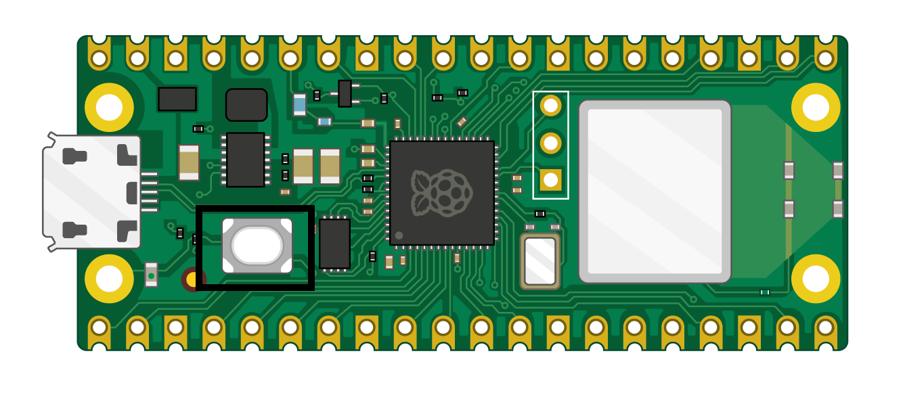
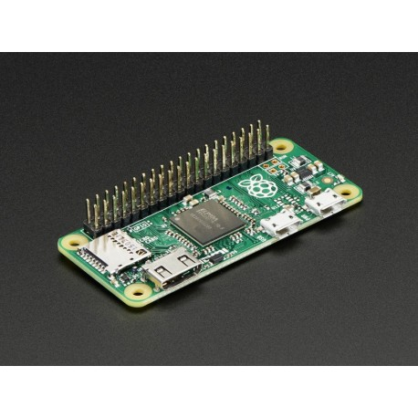
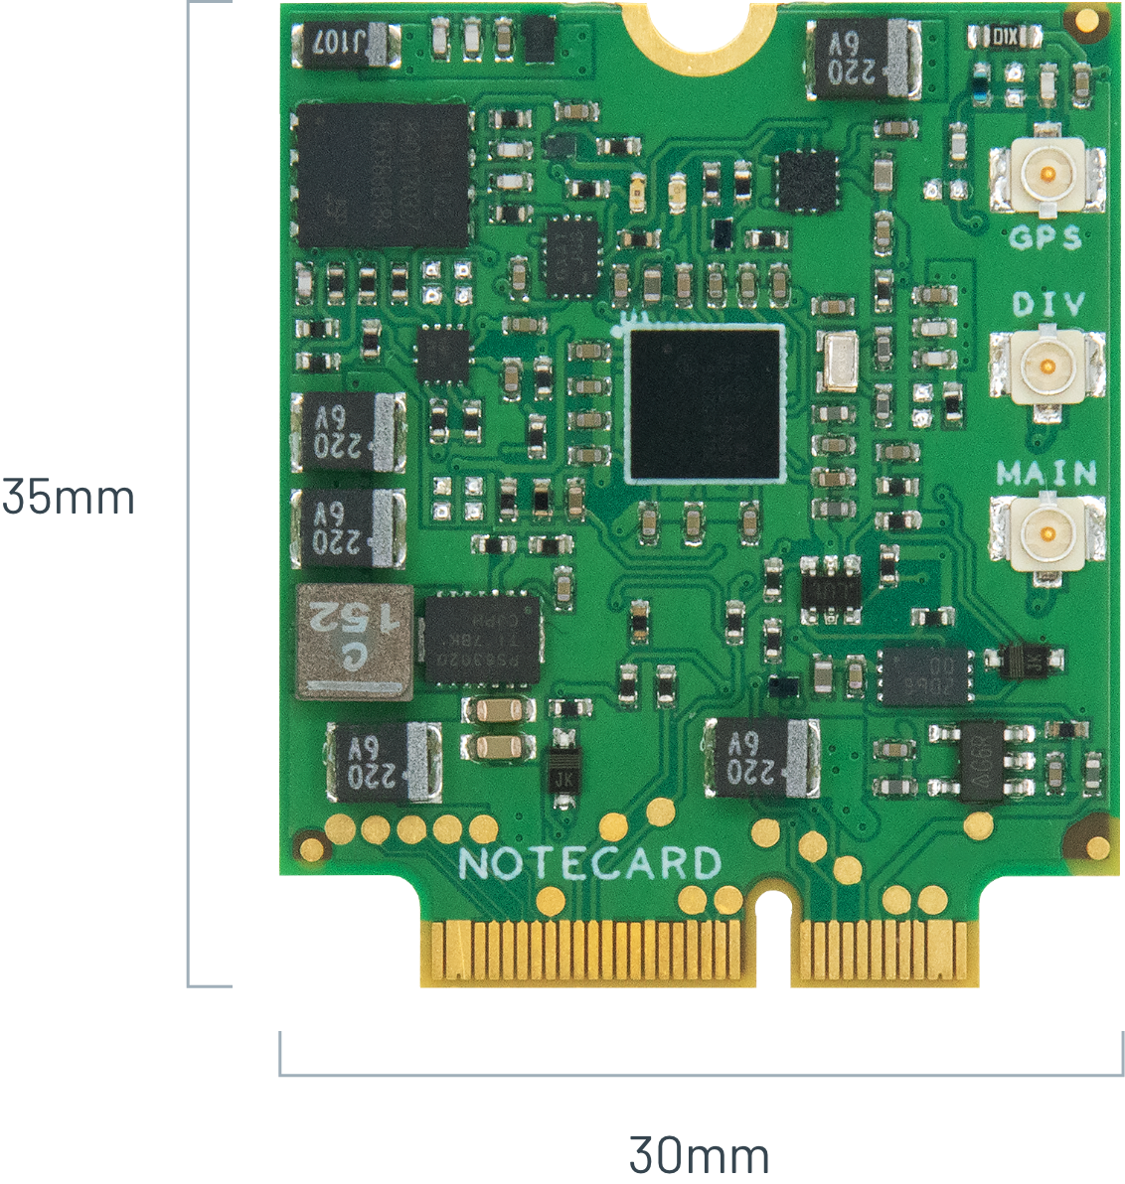
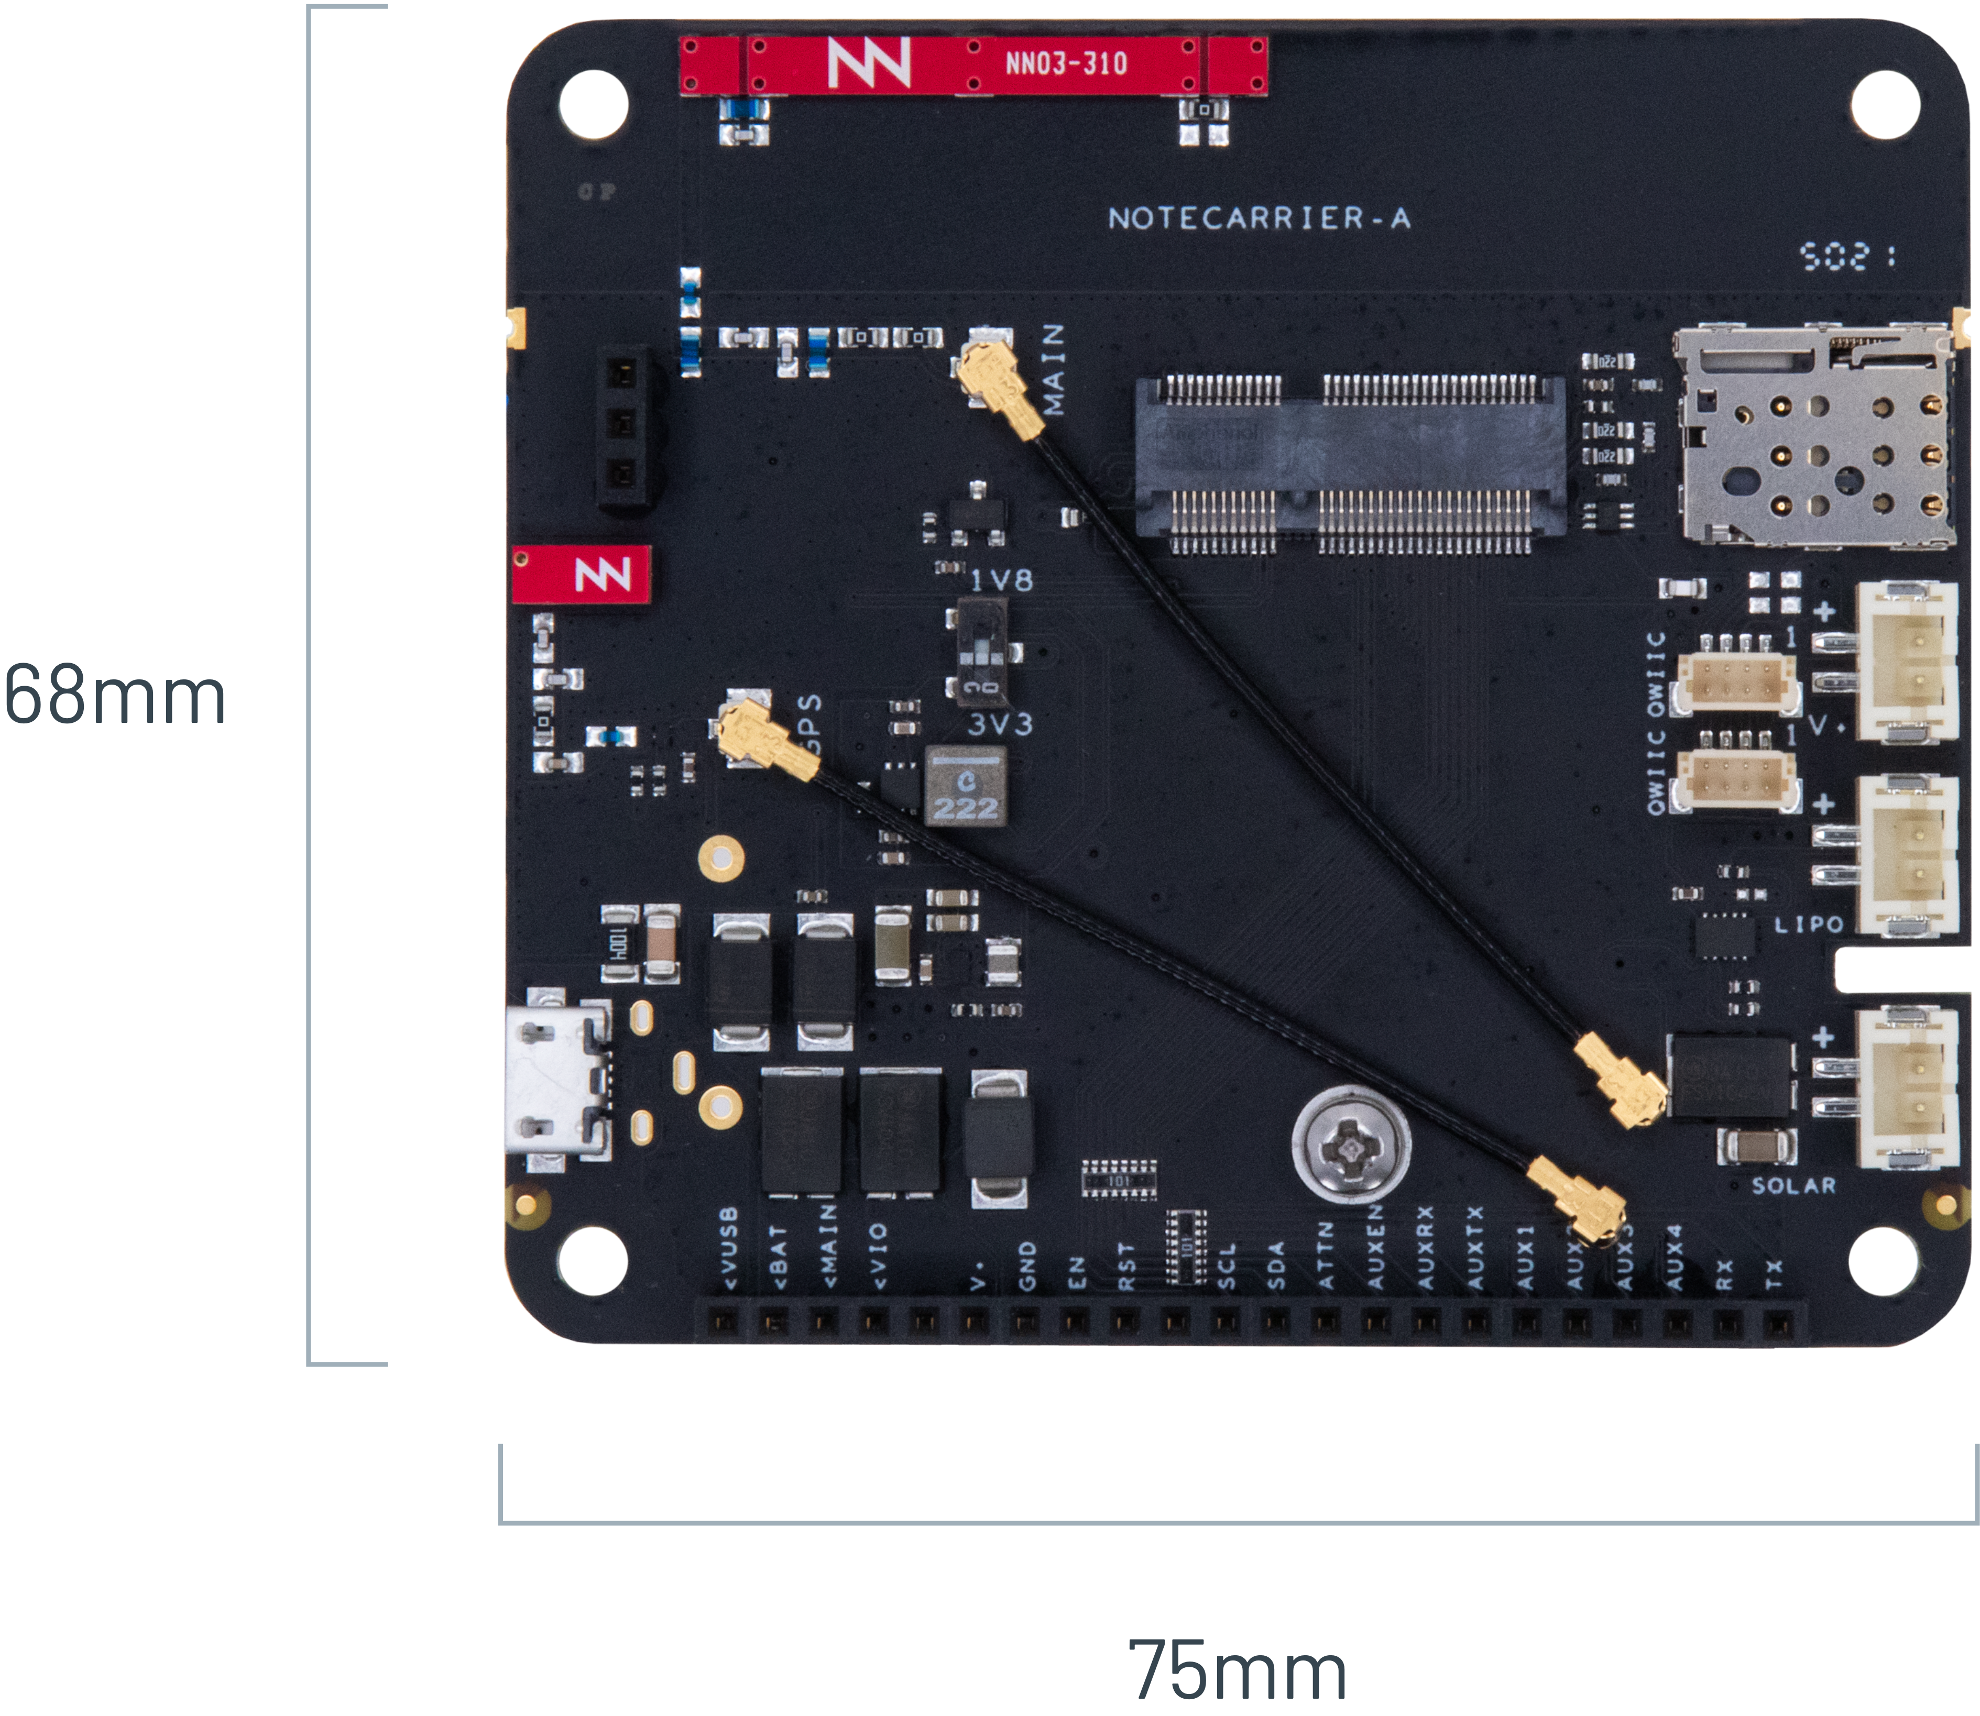
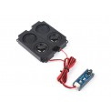
Hardware
Raspberry Pi Pico
The main microcontroller and foundation for the IoT project.
Male Header Set for Raspberry Pi Pico x2
Those male header pins are used to connect the Pico to the Waveshare board and to the notecarrier.
Blues Notecard (Cellular)
The Notecard is a small, low-power cellular IoT card that adds wireless connectivity to the Raspberry Pi Pico.
The Notecard has a SIM embedded in it and is used to send and receive data from the cloud.
This Notecard is also Geo-aware, meaning it can be used to get the device's location.
This Notecard uses LTE-M, NB-IoT, or Cat-1 cellular networks, so it can be configured to work in most countries.
Blues Notecarrier-A
The Notecarrier-A is a Raspberry Pi add-on board that allows you to connect a Notecard to a Raspberry Pi Pico.
Waveshare Audio Expansion Module
The Pico-Audio-Exp module is an audio expansion module that provides audio functionality
to the Raspberry Pi Pico.

Slide 16
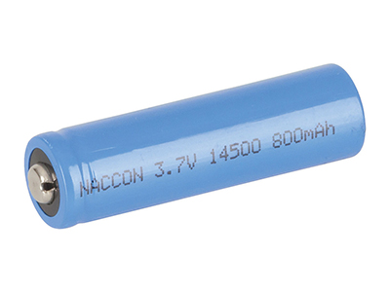
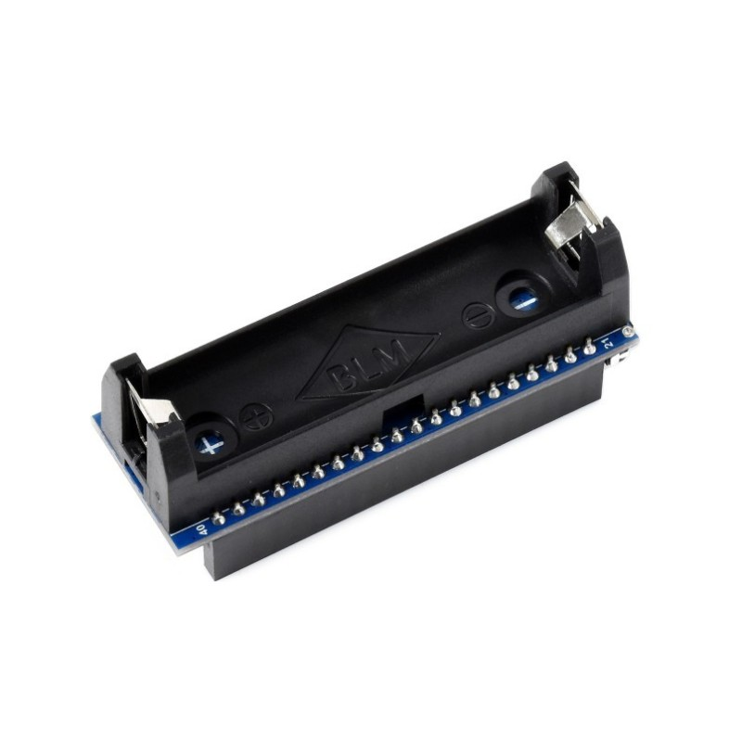

Some more Hardware
14500 Li-ion Battery
A battery is used to power the device.
Battery Holder Power Module
The battery is held in place by a battery holder that is connected to the Waveshare board.
Cellular phone
The Cell-Phone is used in order to install the app communicating with the collar.

Slide 17
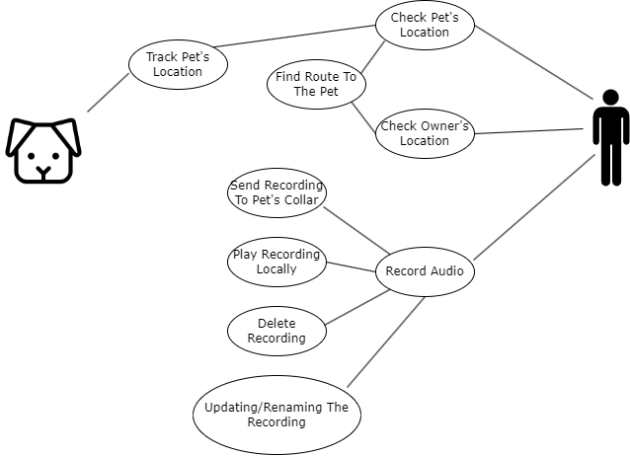
Use Case Diagram

Slide 18
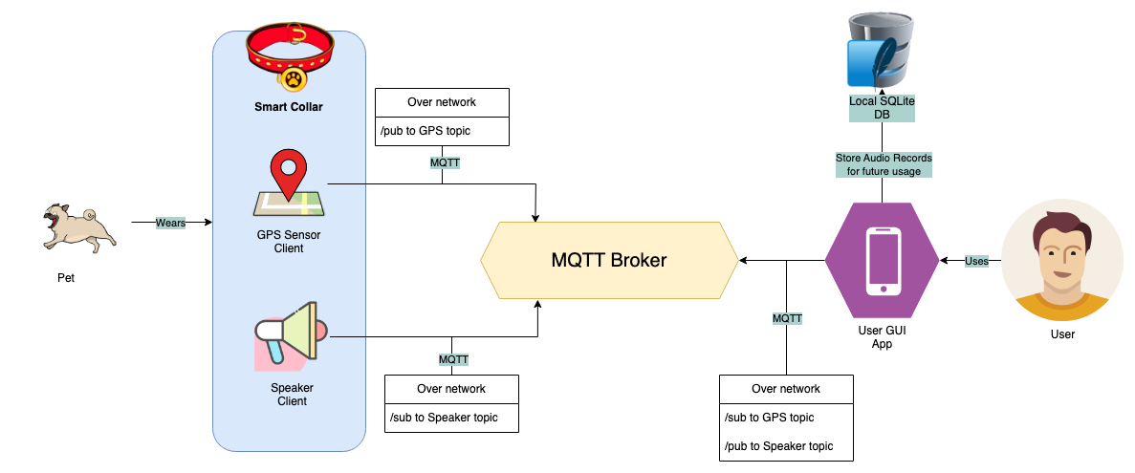
Block Diagram

Slide 19
POC Demo

Slide 20
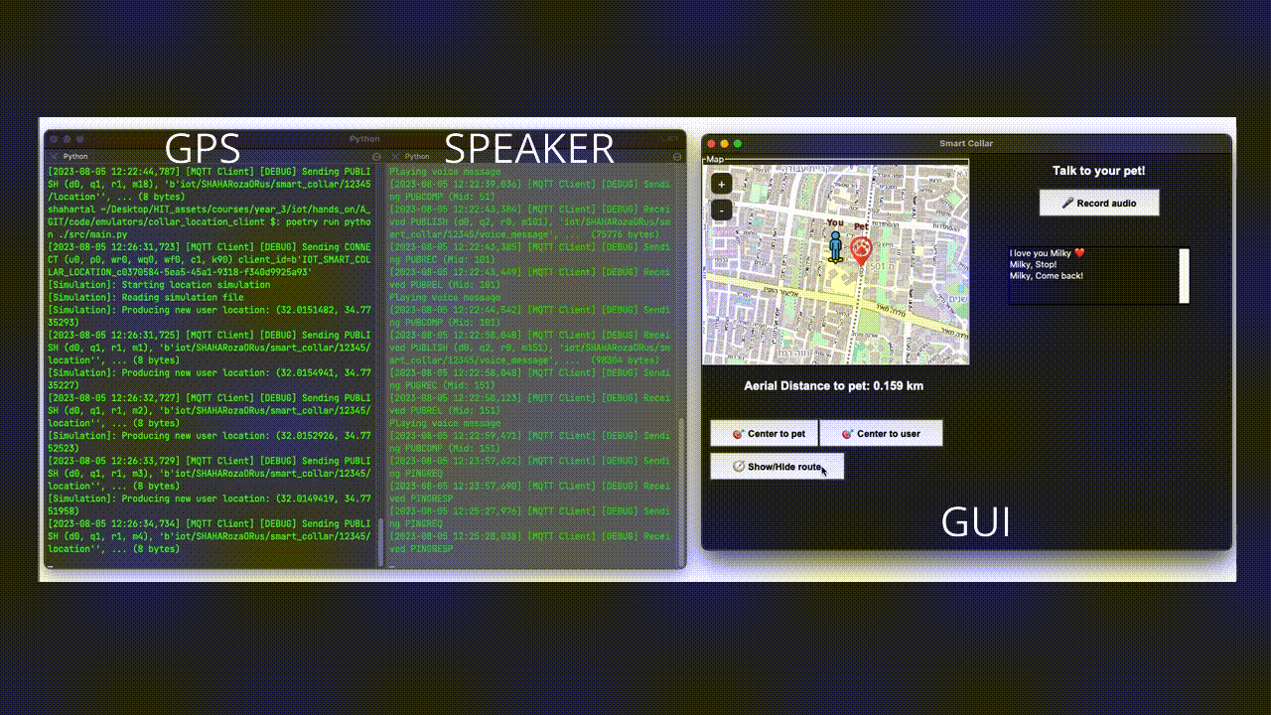

Slide 21
Summary & Bibliography

Slide 22
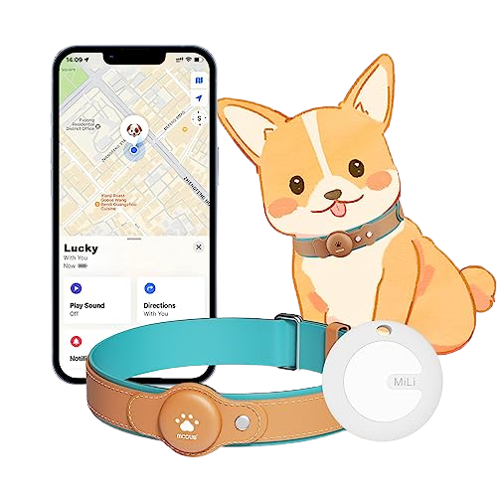
In this presentation, we introduced "Follow UPets," a groundbreaking smart collar designed to address the distressing problem of pets getting lost. As devoted pet owners ourselves, we understand the deep bond between humans and their furry companions and the anxiety that losing a pet can bring.
In the process of making this product we defined, designed and implemented a smart IOT collar and app which using MQTT for network communication and advanced GPS technologies for tracking.
All along working on this project our goal we set on sight was to understand our customers needs to avoid the tragedy of loosing their four-legged friends and making every moment with their loyal companions more enjoyable and worry-free.
Throughout the presentation, we emphasized the importance of non-functional aspects such as performance, accuracy, security, and usability, ensuring that "Follow UPets" is reliable, efficient, and secure.
Links to bibliography –
https://www.hackster.io/brandonsatrom/adding-cellular-to-the-raspberry-pi-pico-b8a4b6
https://docs.python.org/3/library/sqlite3.html
https://python-poetry.org/docs/

Slide 23
Do you have any questions?
THANKS!
Shahar: stalmail10@gmail.com
Or: or3325@gmail.com

